Slide 1

DEVELOPMENT OF IoT BASED SMART PARKING SYSTEM A SOLUTION TO UNBALANCED PARKING DEMANDS SUBMITTED TO DEPT. OF CSE
SUBMITTED BY:
Alankruta padhi
MANNMATH SAMANTARAY
MONALI SENAPATI
MONALISHA MAHAPATRA
SUSHREE SUBHALAXMI DAS
NIHALI CHOUDHURY
SUBHAM ABHISEK
UNDER THE GUIDANCE OF :
DR. NIRANJAN PANIGRAHI
ASSISTANT PROFESSOR

Slide 2
OUTLINE
REQUIREMENT OF A SMART PARKING SYSTEM
IMPORTANCE OF THE SOLUTION
WHAT HAS BEEN DONE
TECHNICAL CHALLENGES
METHODOLOGY AND NETWORK ARCHITECTURE
MATHEMATICAL MODEL
VISUALIZATION OF THE SYSTEM
PERFORMANCE OF THE SYSTEM
CONCLUSION AND FUTUREWORK
REFERENCES

Slide 3
THE PROBLEM
According to International Parking Institute (IPI), 60 percent of the total population will live in cities by 2030, and Green Car Reports (News-feed Reportage Website) estimates that the number of vehicles on the road is about 1.2 billion now and is likely to reach 2 billion by 2035.
There are many wastage instances of natural resources due to the cruising vehicles. Again the carbon footprint on natural biomes is also a considerable factor. Hence, an optimal strategy to find a parking spot can relieve traffic congestion, reduce air pollution and enhance driving comfortability.
Basically in the parking optimization is based on two costs.
Individual Cost
Social Cost

Slide 4
IMPORTANCE OF THE SYSTEM
Smart Parking involves the use of low cost sensors, real-time data and applications that allow users to monitor available and unavailable parking spots. The goal is to automate and decrease time spent manually searching for the optimal parking floor, spot and even lot.
Some top benefits of a parking solution are -
Optimized Parking
Reduced Traffic
Reduced Pollution
Increased Safety
Real-Time Data and Trend Insight

Slide 5
WHAT HAS BEEN DONE
Most advanced parking facilities available in INDIA provide only compact mechanical parking solutions that are based on APS (Automated Parking System). This system provides a vertically stacked parking system that lowers the space and volume consumption of a parking lot. But this type of system does not provide any assistance to the driver if the parking spot is filled. Again the driver goes back to cruise mode and hit-and-try method.
This system also does not maintain a balanced parking network. One APS maybe used to its full extent and others may remain under-used. So basically this type of system does not tackle either the individual cost problem or the social cost problem.

Slide 6
TECHNICAL CHALLENGES
Increase in population of vehicles
Adopting Smart Parking Technology
Enabling the tools and techniques
Controlling of congestion
Countering the issues of over parking and low parking
Fake Parking Requests

Slide 7
METHODOLOGY ADOPTED
Parking Sensors
Central Processing Unit
User Application
The Cloud
An Overhead Display

Slide 8
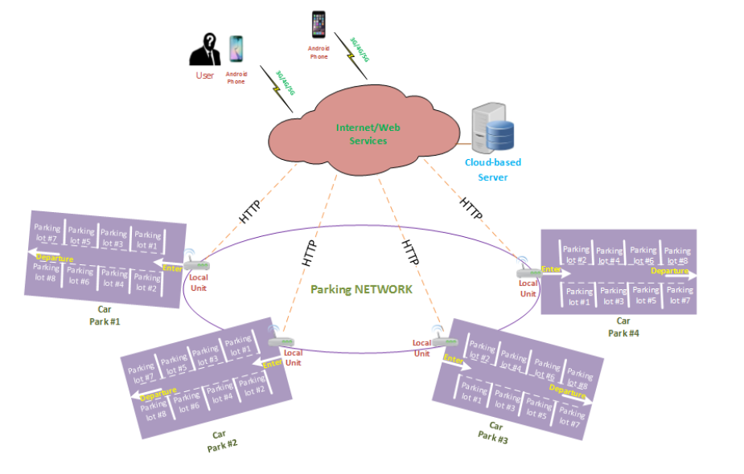
NETWORK ARCHITECTURE

Slide 9

MATHEMATICAL MODEL
Where C (a, b): total cost associated with the searching process
a: coefficient depending upon the length between two nodes
b: coefficient depending upon the number of vacant spaces in destination node
d_{ij}: Distance between two neighbouring nodes (Say node P_{i} and P_{j})
D_{up}: Maximum of the distances between current and the neighbouring nodes.
S_{j} :Number of vacant spaces available at P_{j}
S_{up}: Maximum capacity of the whole network

Slide 10
IMPLEMENTATION OF THE SYSTEM

Slide 11
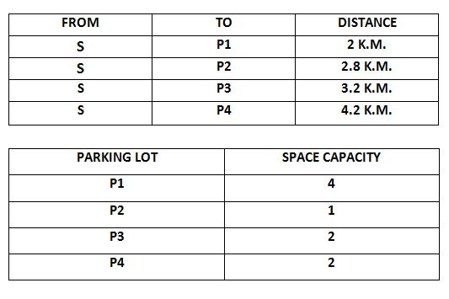
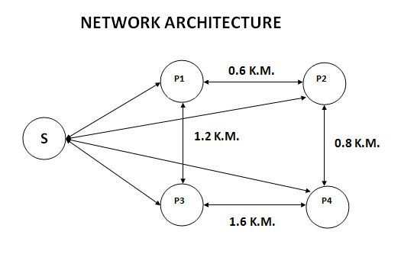

Slide 12
PERFORMANCE OF THE SYSTEM

Slide 13
CONCLUSION
From the simulation it was concluded that the system shows its best optimality when the values of a and b are 0.2 and 0.8 respectively.
A perfectly balanced distribution of vehicles was realized among the parking lots. This distribution considers both the number of spaces occupied along with the travelling distance between the lots.
And if a lot is completely occupied then the next vehicle is transferred to its neighbour nodes to find out a free space if available.

Slide 14
FUTUREWORK
Hardware implementation of the discussed idea.
Use of sensors and IoT to realize the system.
RFID implementation in the system for vehicle authentication.

Slide 15
REFERENCES
Parikng assignment problem: An algorithm for balancing parking demand on multiple parking lots – Oanh Tran Thi Kim, VanDung Nguyen
IoT based smart parking system – AbhirupKhana, Rishi Anand
A new “Smart Parking” System Infrastructure and Implementation - YanfengGeng, Christos G. Cassandras
A Reservation-based Smart Parking System - Hongwei Wang

Slide 16
Thank you….

